Slide 1

Camera Chameleon
Hey there, Welcome to
Camera Chameleon!
Let’s find the best camera for you
Final Presentation
Ankur Kumar, Sadiya Nur, Richa Prajapati, Matan Sela, Michael Young

Slide 2
Project Overview

Slide 3
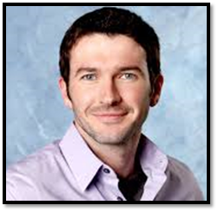
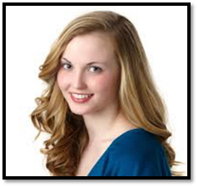
Product Development Timeline
1
2
3
4
5
6
Conduct user interviews
Identify pain points in conducting online reviews
Identify Persona & Use case & Use case instance
Match prototype to Persona → Pivot
Further interviews and Identify MVP
Conduct experimentation & analyses
From:
To:
John, 27
Smart and sophisticated shopper
Does intensive online research and likes learning about different product features. Focuses on the quality and inclusiveness of the search results.
Becky, 27
Wants to enjoy life and to make the right choices in an effective way. Does not enjoy the search process and looks for “life hacks” to find the best solution in the most efficient way

Slide 4
JOB-TO-BE-DONE
When?
When looking for expensive, complex and unfamiliar products.
Why?
To find out what is the product and features that is the best fit for them.
What are the pain points?
Information overload - Different products and sources of information
Time consuming and complex research process.
JOB TO BE DONE
For the first time camera buyers discover what are the most important features for them and find the best products based on those features.

Slide 5
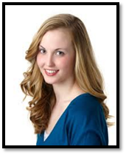
Persona
Becky is a 27 year old MBA student at UC Berkeley living in San-Francisco.
She is comfortable around technology but is not a techie. She has limited
money to spend, leading her to conduct intensive online research prior to major
expenditures, especially when shopping for unfamiliar items.
Motivations:
Becky want to live life to the fullest and time is just as scarce a resource as money is. She takes pride in “making the smart choices” and “life hacking” complex problems efficiently find the best solution.
Goals:
Becky wants to make the best decision quickly. She does not enjoy the search process but also hates feeling like she made the wrong decision so does it to find the right product for her. She wishes there was an easier way to find out what she needs to know to make her decision.

Slide 6
Minimal Viable Problem
Minimum Viable Problem:
Help first time camera buyers find the best cameras for them by identifying the most important features for them and suggesting cameras based on those features
Use Case
For non-professional photographers, acquiring their first camera, Camera Chameleon provides an efficient way to replace the online search process with one session by:
Identify relevant camera features.
Suggest the best camera for the user based on those features.

Slide 7
Feedback From User Testing
WHAT DID THE USER’S SAY ?
"I think the app is a really good idea, and I wish I'd had it when I bought a camera for traveling.”
"If I knew someone who was in the market I'd tell them about it for sure.”
"I loved the game to find what features are important to me in a camera”
"If I had had this to help me out I could have made a better decision.”
WHAT WERE SOME OF THE ISSUES?
Feature screen - It was a bit confusing, and had a lot of information.
Results screen - The interface was not intuitive enough.
Email - Email confirmation was missing.
WHAT DID WE DO WITH THE FEEDBACK ?
We improved our prototype by incorporating the feedback from the first test, into our second test.

Slide 8
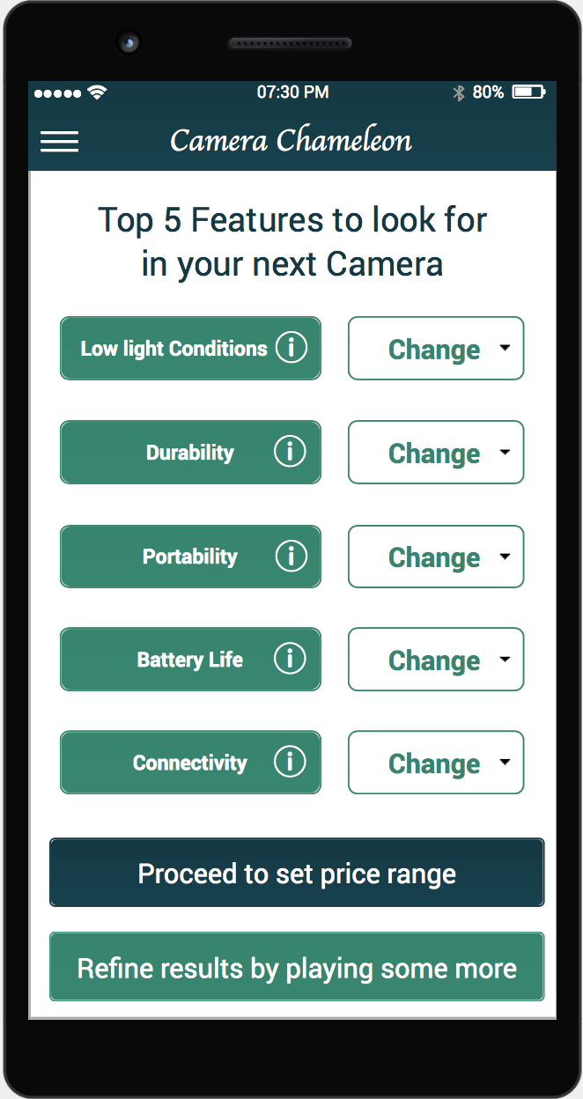
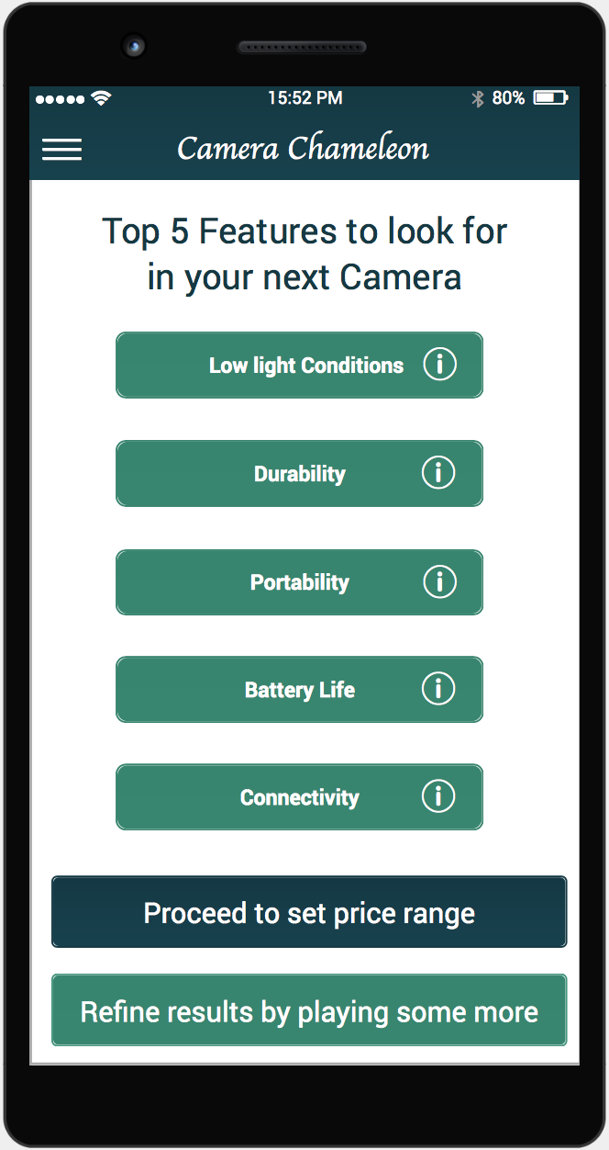
Feedback From User Testing
WHAT DID THE USER’S SAY ?
"I think the app is a really good idea, and I wish I'd had it when I bought a camera for traveling.”
"If I knew someone who was in the market I'd tell them about it for sure.”
"I loved the game to find what features are important to me in a camera”
"If I had had this to help me out I could have made a better decision.”
WHAT WERE SOME OF THE ISSUES?
Feature screen - It was a bit confusing, and had a lot of information.
Results screen - The interface was not intuitive enough.
Email - Email confirmation was missing.
WHAT DID WE DO WITH THE FEEDBACK ?
We improved our prototype by incorporating the feedback from the first test, into our second test.

Slide 9
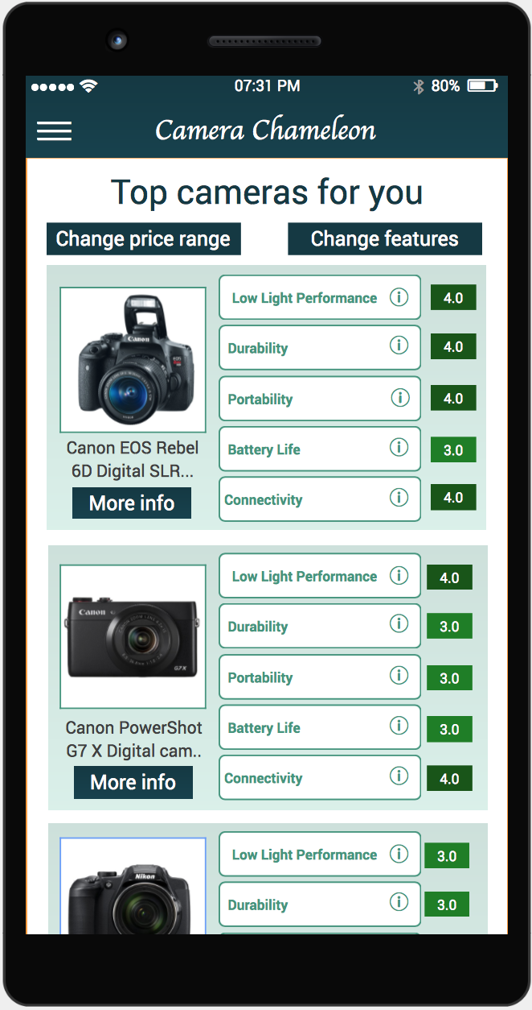
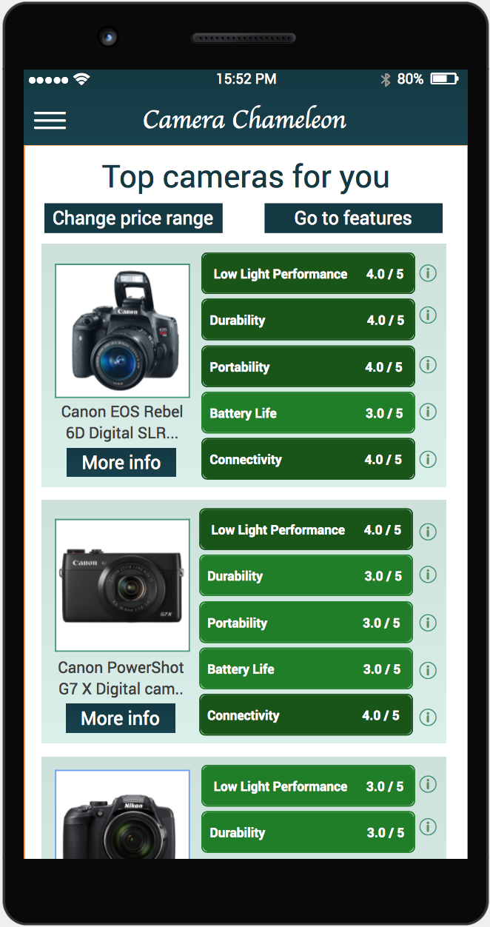
Feedback From User Testing
WHAT DID THE USER’S SAY ?
"I think the app is a really good idea, and I wish I'd had it when I bought a camera for traveling.”
"If I knew someone who was in the market I'd tell them about it for sure.”
"I loved the game to find what features are important to me in a camera”
"If I had had this to help me out I could have made a better decision.”
WHAT WERE SOME OF THE ISSUES?
Feature screen - It was a bit confusing, and had a lot of information.
Results screen - The interface was not intuitive enough.
Email - Email confirmation was missing.
WHAT DID WE DO WITH THE FEEDBACK ?
We improved our prototype by incorporating the feedback from the first test, into our second test.

Slide 10
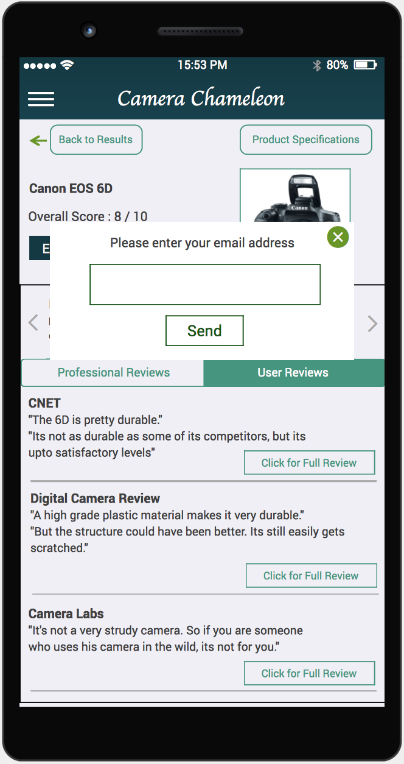
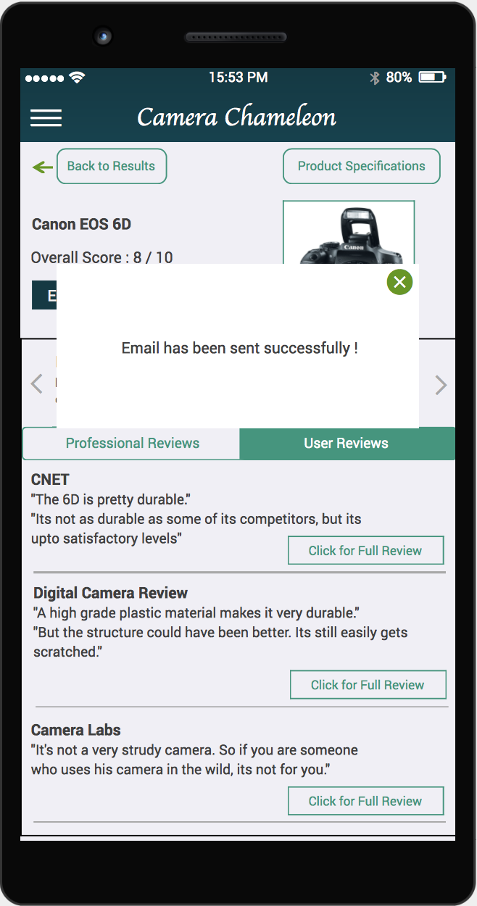
Feedback From User Testing
WHAT DID THE USER’S SAY ?
"I think the app is a really good idea, and I wish I'd had it when I bought a camera for traveling.”
"If I knew someone who was in the market I'd tell them about it for sure.”
"I loved the game to find what features are important to me in a camera”
"If I had had this to help me out I could have made a better decision.”
WHAT WERE SOME OF THE ISSUES?
Feature screen - It was a bit confusing, and had a lot of information.
Results screen - The interface was not intuitive enough.
Email - Email confirmation was missing.
WHAT DID WE DO WITH THE FEEDBACK ?
We improved our prototype by incorporating the feedback from the first test, into our second test.

Slide 11
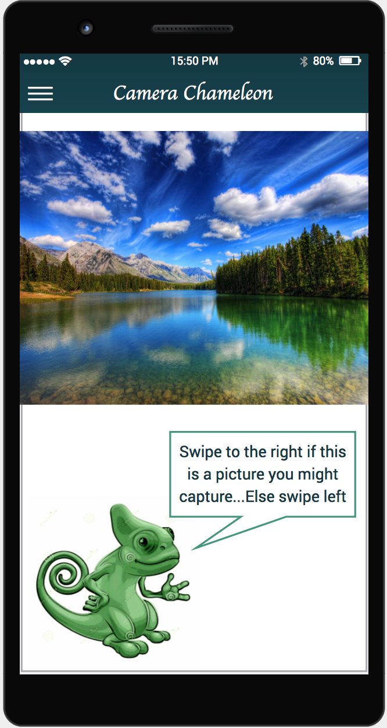
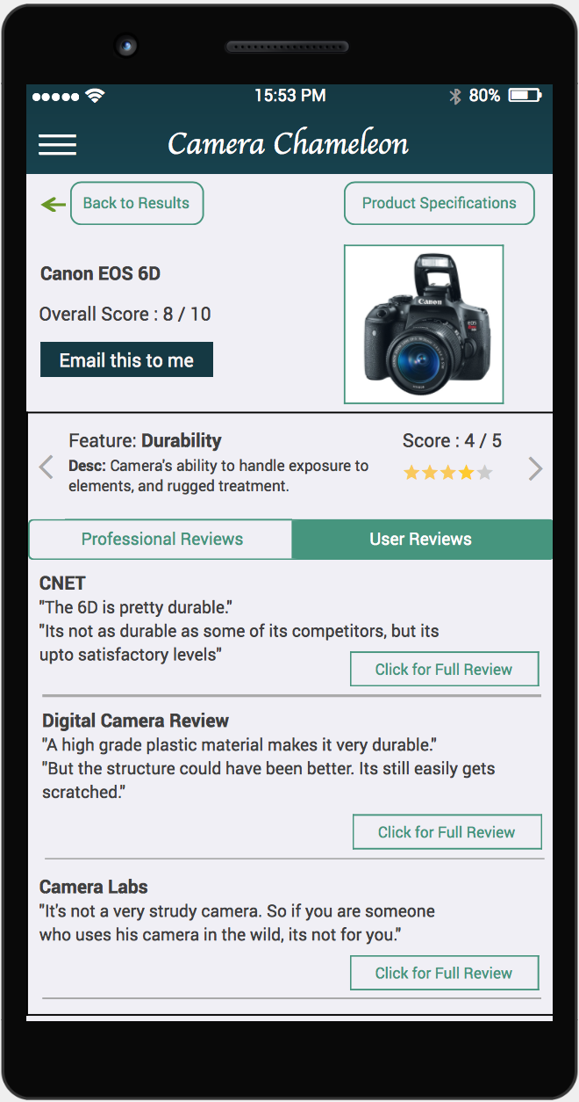
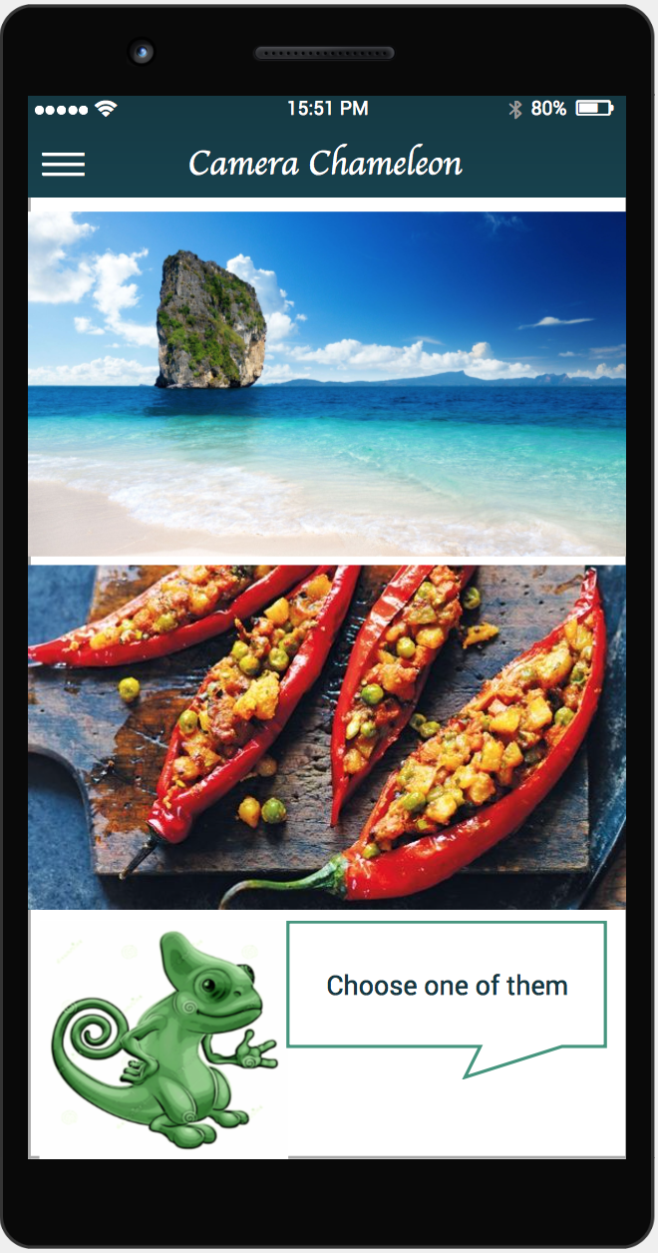
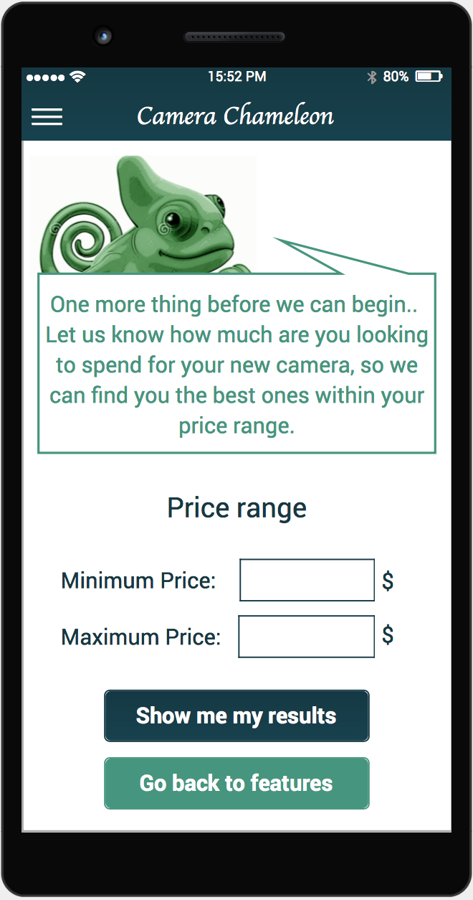
Product Demo
Camera
Chameleon
Shows a series of photos
Shows top 5 features important for selected photos
Shows relevant cameras
Displays professional and user reviews
Sends Product Reviews and Details to user
User
Click on a
product
Enters Email address
Accepts/rejects the photos
Sets price range
Notes:
You swipe multiple such pictures

Slide 12
Product Demo
Camera
Chameleon
Shows a series of photos
Shows top 5 features important for selected photos
Shows relevant cameras
Displays professional and user reviews
Sends Product Reviews and Details to user
User
Click on a
product
Enters Email address
Accepts/rejects the photos
Sets price range
Notes:
You swipe multiple such pictures

Slide 13
Product Demo
Camera
Chameleon
Shows a series of photos
Shows top 5 features important for selected photos
Shows relevant cameras
Displays professional and user reviews
Sends Product Reviews and Details to user
User
Click on a
product
Enters Email address
Accepts/rejects the photos
Sets price range
Notes:
If you keep swiping only left or only right, it will force you to choose one picture

Slide 14
Product Demo
Camera
Chameleon
Shows a series of photos
Shows top 5 features important for selected photos
Shows relevant cameras
Displays professional and user reviews
Sends Product Reviews and Details to user
User
Click on a
product
Enters Email address
Accepts/rejects the photos
Sets price range
Notes:
More information about why each feature was selected can be accessed by tapping on the ‘i’ icon. Doing so shows the next screen

Slide 15
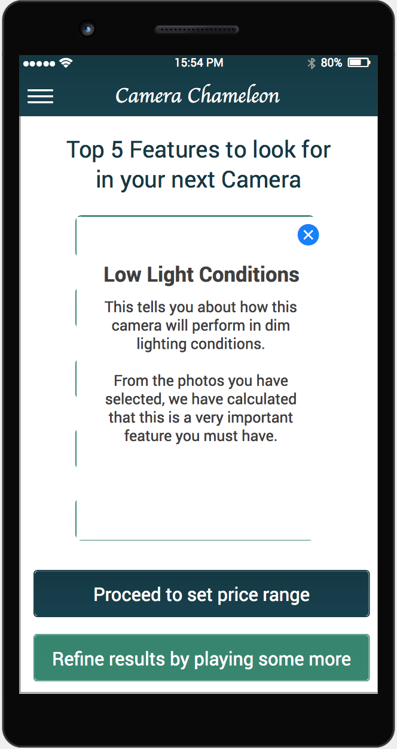
Product Demo
Camera
Chameleon
Shows a series of photos
Shows top 5 features important for selected photos
Shows relevant cameras
Displays professional and user reviews
Sends Product Reviews and Details to user
User
Click on a
product
Enters Email address
Accepts/rejects the photos
Sets price range
Notes:
This is the dialog box that tells you why a particular features was selected to be important. The description will be different for different features

Slide 16
Product Demo
Camera
Chameleon
Shows a series of photos
Shows top 5 features important for selected photos
Shows relevant cameras
Displays professional and user reviews
Sends Product Reviews and Details to user
User
Click on a
product
Enters Email address
Accepts/rejects the photos
Sets price range
Notes:
If you select “Proceed to set price range”, you will be taken to the next screen.
If you select “Refine results by playing some more”, you will be be asked to swipe left/right different set of pictures again.

Slide 17
Product Demo
Camera
Chameleon
Shows a series of photos
Shows top 5 features important for selected photos
Shows relevant cameras
Displays professional and user reviews
Sends Product Reviews and Details to user
User
Click on a
product
Enters Email address
Accepts/rejects the photos
Sets price range
Notes:
Clicking on “Show me my results” will take you to the next screen.

Slide 18
Product Demo
Camera
Chameleon
Shows a series of photos
Shows top 5 features important for selected photos
Shows relevant cameras
Displays professional and user reviews
Sends Product Reviews and Details to user
User
Click on a
product
Enters Email address
Accepts/rejects the photos
Sets price range
Notes:
This screen shows you top 5 cameras (in descending order) that the algorithm deemed best fit as per your requirements. It shows how the product was rated on the different features via ratings and color gradient.
This screen also allows you to change your price range or features.
Clicking on the camera picture or “more info” will take you to that product’s description.
Clicking on each feature bar will take you another screen showing why it was given that particular rating depending on professional and user reviews.

Slide 19
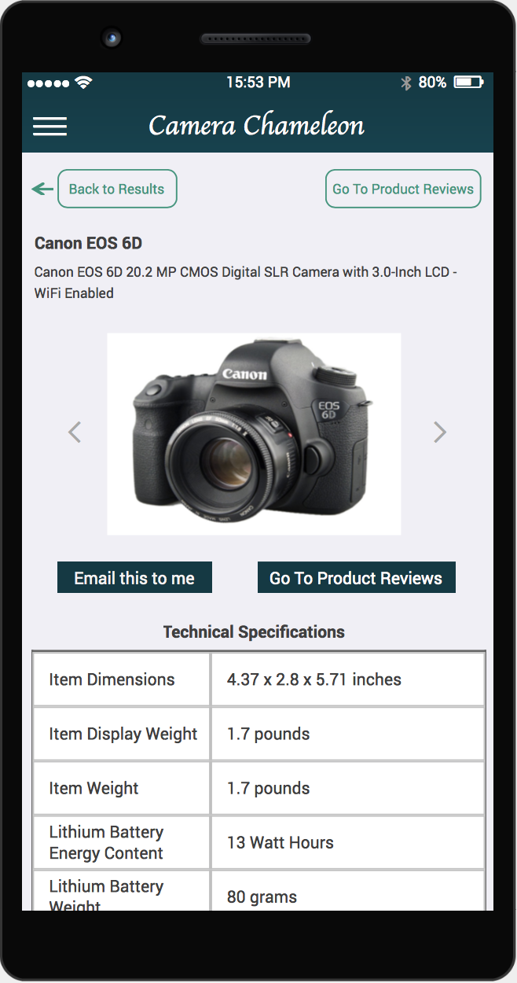
Product Demo
Camera
Chameleon
Shows a series of photos
Shows top 5 features important for selected photos
Shows relevant cameras
Displays professional and user reviews
Sends Product Reviews and Details to user
User
Click on a
product
Enters Email address
Accepts/rejects the photos
Sets price range
Notes:
Screen for product description.
You can go to the product reviews showcasing how why the rating was given to each of the 5 selected features depending on professional and user reviews.
You can also email all this information to yourself.

Slide 20
Product Demo
Camera
Chameleon
Shows a series of photos
Shows top 5 features important for selected photos
Shows relevant cameras
Displays professional and user reviews
Sends Product Reviews and Details to user
User
Click on a
product
Enters Email address
Accepts/rejects the photos
Sets price range
Notes:
This screen shows the professional reviews that gave rise to rating of “durability” features

Slide 21
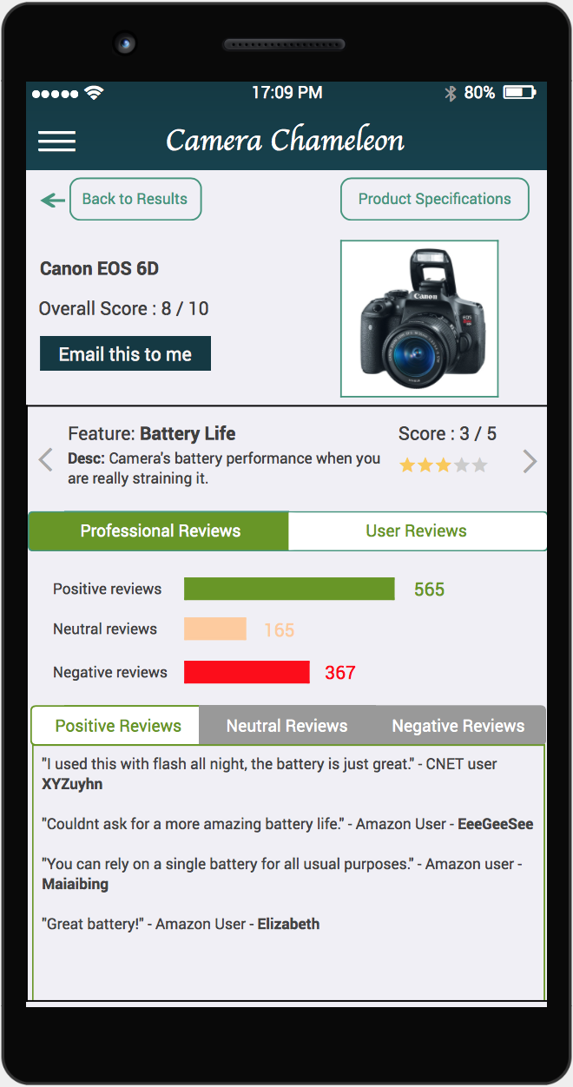
Product Demo
Camera
Chameleon
Shows a series of photos
Shows top 5 features important for selected photos
Shows relevant cameras
Displays professional and user reviews
Sends Product Reviews and Details to user
User
Click on a
product
Enters Email address
Accepts/rejects the photos
Sets price range
Notes:
This screen shows the “user reviews” that gave rise to the rating of “battery life” feature

Slide 22
Product Demo
Camera
Chameleon
Shows a series of photos
Shows top 5 features important for selected photos
Shows relevant cameras
Displays professional and user reviews
Sends Product Reviews and Details to user
User
Click on a
product
Enters Email address
Accepts/rejects the photos
Sets price range
Notes:
Here you can enter the address you want this information to be sent to

Slide 23
Product Demo
Camera
Chameleon
Shows a series of photos
Shows top 5 features important for selected photos
Shows relevant cameras
Displays professional and user reviews
Sends Product Reviews and Details to user
User
Click on a
product
Enters Email address
Accepts/rejects the photos
Sets price range
Notes:
Confirmation of email.

Slide 24
Project Key Takeaways
1
Iterative user testing, and feedback integration.
2
If your solution gets too complicated, don’t be afraid to pivot.
3
Start as small as possible.
Notes:
; apart from simplifying the code, it also helps build a more concrete story.

Slide 25

Thank you !
Questions?

Slide 26
Appendix

Slide 27
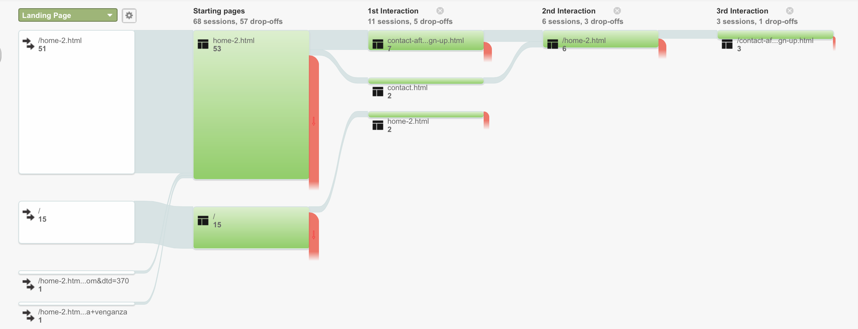
A/B Test Results:
14% conversion rate of Version B vs 0% conversion rate of Version A
More people seemed to trust/install Camera Chameleon if the landing page tells them how it decides what is the best camera for them rather than just telling them that it can find the best camera for them

Slide 28
Ad Campaign
Objective
Drive traffic to camera chameleon website
Duration
5 days
Sample size
207
Insight gathered
Most traffic comes from Google Display Network (189), not Google search (18).
Used hybrid campaign: combination of Search and Display (because of photo sharing sites like instagram and pinterest). Display CTR Baseline 0.1%, we outperformed achieving 2.11%. Search campaign baseline = 1% achieved .3%
 |  | Audience
 |  | Impressions | Avg. CPC | Avg. Pos. | CTR
Messaging | Features | 55,984 | $.49 | 1.1 | .11%
 | Quality | 8,548 | $.32 | 1.1 | 2.85%

